Slide 1
Buffy as an Apocalyptic Narrative

Slide 2
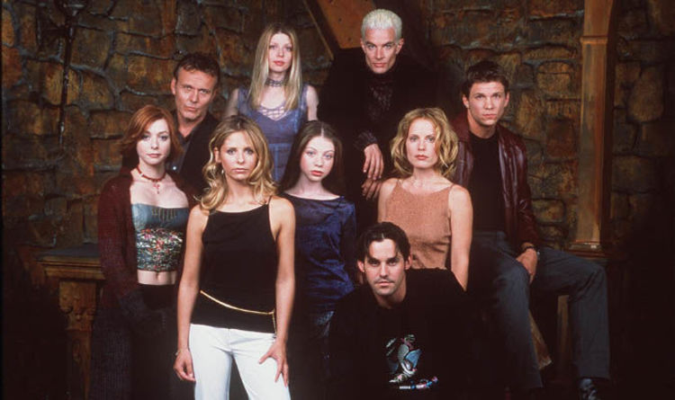
Buffy the Vampire Slayer
1997-2003
Notes:
Created/produced by Joss Whedon
An epitome of the apocalypse genre
Image Source: https://www.express.co.uk/showbiz/tv-radio/1002958/Buffy-the-vampire-slayer-reboot-2018-release-date-cast-plot-trailer-joss-Whedon-podcast

Slide 3
“Hush” Season 4, Episode 10
Notes:
A brief introduction to The Gentlemen, the villains of this episode
Image Source: https://www.youtube.com/watch?v=KKfNuMWO128

Slide 4
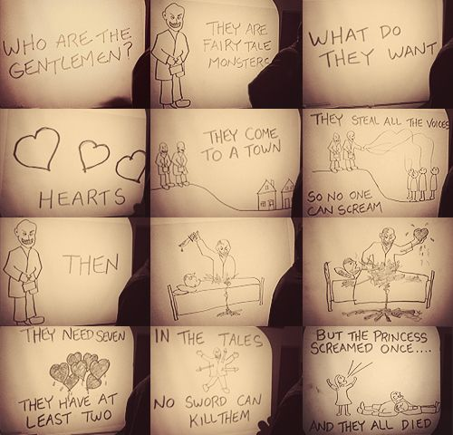
Plot Summary
Villains: The Gentlemen
Fairytale monsters who go from town to town stealing people’s voices and then murdering them
Their goal is to obtain 7 human hearts
The only thing that can kill them is a human scream (real- an audio clip of a scream will not work)
Main Characters: Buffy, Riley, Xander, Anya, Willow, Giles, Spike, Tara
Notes:
Only 17 minutes of the 44-minute episode contain actual dialogue
Use of stunning visuals, an amazing film score, and exaggerated examples of nonverbal communication
Image Source: https://www.pinterest.com/pin/249175791853792903/

Slide 5
Themes
Main Theme:
Communication + Language
Other:
Apocalypse
Disruption of normal life
Exploration of common fears/paranoia
Political commentary
Notes:
The Gentlemen coming to town is not the sole conflict of the episode → the focus is on communication/miscommunication

Slide 6
Talking about communication, talking about language. Not the same thing. It’s about the way a child can recognize and produce phonemes that don’t occur in its native language. It’s about inspiration: not the idea, but the moment before the idea; when it’s total, when it blossoms in your mind and connects to everything, before the coherent thought that gives it shape, that locks it in and cuts it off from the universal. When you can articulate it, it becomes smaller. It’s about thoughts and experiences that we don’t have a word for.
Notes:
Verbal language, like speech, can act as a barrier to communication because it limits a person’s ability to express how they feel (Dornan, 2017)
Language can interfere with communication because people tend to “use language as white noise” and “misuse it horribly” sometimes, like by telling lies (Whedon, 2003)
This use of language can be considered locutionary and conveys little meaning (Jenkins & Stuart, 2003)

Slide 7
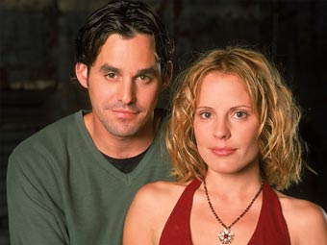
(Mis)communication
Buffy + Riley
Babbling; unable to communicate how they feel about each other and progress their relationship
Keeping secrets about their true identities
Xander + Anya
Anya is frustrated because Xander is unable/unwilling to express to her what she means to him
Willow + Wicca
Willow is frustrated because she wants to expand her magical abilities, but her Wicca group is all talk – the group cares more about bake sales than magic
Notes:
The first third of the episode contains the most dialogue, and yet it is full of miscommunication, arguments, and characters withholding information from other characters
Image Sources (left to right): https://www.syfy.com/syfywire/the-worst-boyfriends-of-buffy-the-vampire-slayer, http://www.bbc.co.uk/cult/buffy/gallery/season5/anyaxander_s5.shtml, & https://en.wikipedia.org/wiki/Willow_Rosenberg

Slide 8
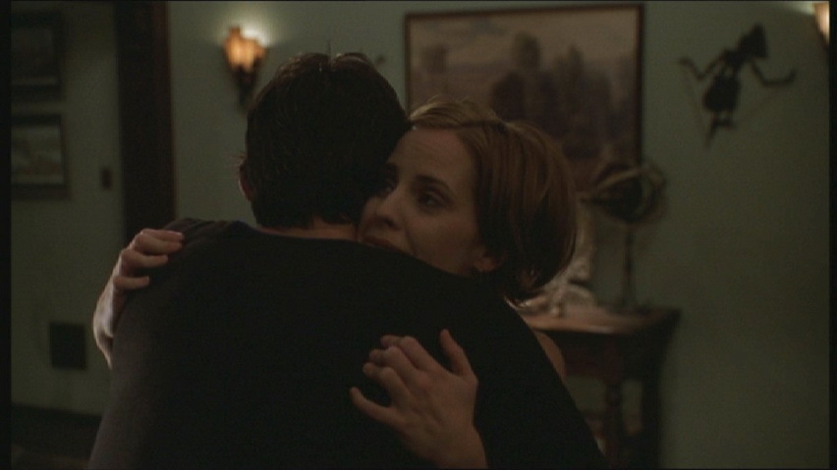
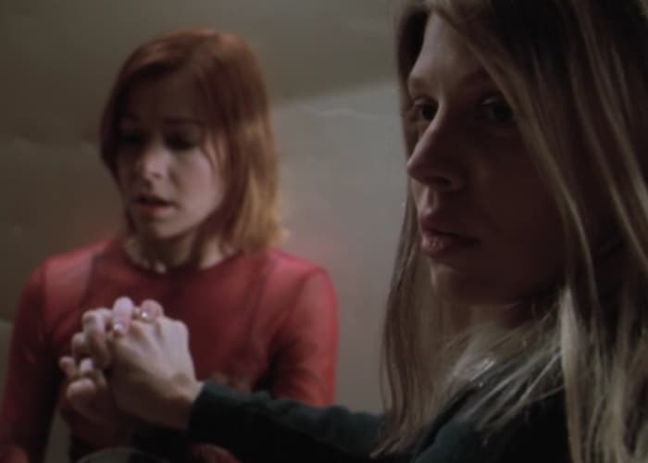
Communication
Buffy + Riley
Buffy and Riley kiss spontaneously and progress their relationship when they run into each other in town
Xander + Anya
Xander is finally able to show Anya just how much she means to him
He beats up Spike, who he mistakenly thinks killed her
Willow + Wicca
Willow forms a new connection with Tara
They work together using magic to escape The Gentlemen
Notes:
By removing the characters’ ability to speak, it forces them to rely on nonverbal communication to solve their issues
Initially, the characters are distraught and confused by their sudden loss of speech, but as the episode progresses, the characters work past this barrier by using nonverbal communication techniques and are even able to express themselves more fully that if they had used speech
The nonverbal communication techniques utilized are perlocutionary – they convey deeper meaning and evoke action (Jenkins & Stuart, 2003)
Image Sources (left to right): http://offline.buffy.de/outlink_en.php?module=/webserver/offline/angel.fcpages.com/csriley2.html, http://images2.fanpop.com/image/photos/10100000/Hush-4x10-buffy-the-vampire-slayer-10138964-852-479.jpg, & https://filmschoolrejects.com/buffy-hush/

Slide 9
Main Message
“When we stop talking, truths start coming out” – Joss Whedon (Kuhn, 2003)
Importance of nonverbal communication
Notes:
The main message of this episode comes from the commentary on language and communication
While talking is important, it is more important for people to be able to fully convey their emotions without misusing language as white noise or as a means of avoiding the truth, which can sometimes be easier to convey through nonverbal communication
Unconventional

Slide 10
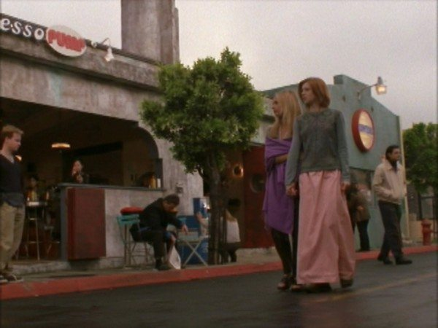
Disruption of Normal Life
Chaos
Initial confusion/hysteria
People wandering around town aimlessly
Bank is closed but liquor store is still open
Preacher leading a reading of Revelation 15:1
People selling whiteboards for $10 each
Later: Fights, fires, vandalism
Notes:
Conventional
In just a few scenes, normal life is disrupted, and Sunnydale swiftly descends into chaos
Revelation 15:1: “And I saw another sign in heaven, great and marvelous, seven angels having the seven last plagues; for in them is filled up the wrath of God.”
Whedon states that he included this shot to indicate how “Religious craziness” tends to pop up “the moment there’s a problem” (Whedon, 2003)
Whedon notes that whenever he thinks about “rampant capitalism” popping up “the moment there’s a problem,” like this scene portrays, he thinks “of people selling American flags within five seconds after the World Trade Center incident” (Whedon, 2003)
Image Source: https://persephonemagazine.com/2013/04/retro-recap-buffy-the-vampire-slayer-s4-e10-hush/

Slide 11
Comparison
Reliance and dependence of citizens on alcohol
Future Home of the Living God
Rampant capitalism
The Year of the Flood, Zone One
Seeking an explanation through religion for the destruction that has been caused
Future Home of the Living God, The Year of the Flood, Station Eleven
Social collapse, people fighting, & stores being ransacked
Pretty much every novel

Slide 12
Fear/Paranoia
The Gentlemen & their footmen
Childhood dream
Nosferatu, Pinhead, Mr. Burns – anything creepy, classical, nightmarish
Local authorities
Laryngitis caused by flu vaccinations?
Notes:
In an interview , Whedon states that his inspiration for The Gentlemen was a childhood dream that he had about figures floating at him while being unable to scream (Pallotta, 2014)
Whedon adds that all of the elements of The Gentlemen – the Victorian kind of feel, the politeness, the suits, the footmen – came from his dream, Nosferatu, Pinhead, Mr. Burns, or anything else that he thought would convey a creepy, classical feel (Whedon, 2003)
He also notes that they hired mostly mimes for the episode, so The Gentlemen would appear more realistic and terrifying
The portrayal of isolation, of helplessness and vulnerability, and people being too frightened to help each other that drives home the terror in this episode (Whedon, 2003)
Initially, a written statement about the issue in Sunnydale is released by local authorities, who contribute it to a mysterious town wide epidemic of laryngitis caused by recent flu vaccinations
A dig at the infamous paper claiming that vaccines cause autism in children
Local authorities fail to address the real issue at hand
Image Source: https://giphy.com/gifs/MspmkHBI8QA9y

Slide 13
Political Commentary
Bill of Rights
Freedom of speech
The Gentlemen are comparable to authoritarian leaders who censor their citizens
Censorship helps oppress
Ultimately, speech (and free speech) is essential because it allows for some form of governmental accountability
Notes:
In Giles’ research into these fairytale villains, he writes, “Political ref? re. Bill of Rights.” → the act of The Gentlemen taking away the townspeople’s voices can be interpreted as symbolic
The silence that results isolates the members of the community and weakens their attempts to fight off the evil (Shade, 2005)
The silencing that The Gentlemen do can be seen as a metaphor for the way evil is spread, by interfering with communication and silencing dissent (Murray, 2009)
The actions of The Gentlemen can be compared to those of authoritarian leaders who censor their citizens and take away freedom of speech so no one can speak about their evil deeds and overthrow them (Russomanno, 2020)
Under a censorship regime, the government cannot be held accountable because the political voices of the public and the media are censored to conceal truths
The issue of communication is dynamic; nonverbal communication can be more important than verbal communication, since it can allow a person to communicate how they really feel without limiting themselves by words, but on the other hand, lack of verbal communication can also cause society to crumble and permit citizens to be oppressed

Slide 14
Conclusion
An epitome of apocalyptic narratives
Stunning visuals showing dystopian transformation of town
Portrayal of coping mechanisms (turning to religion, booze)
Preys on common fears like not being able to scream when attacked and feelings of isolation, concern about vaccinations
Provides political commentary
Ultimately, this episode explores the limits and assets of language and communication, showing how essential both nonverbal and verbal communication are
1:50 / 2:21
Notes:
Ultimately, televised apocalyptic narratives can be just as effective as written narratives
Image Source: https://www.youtube.com/watch?v=iCaRK5qo3KI
Context: Buffy and Riley defeat The Gentlemen

Slide 15
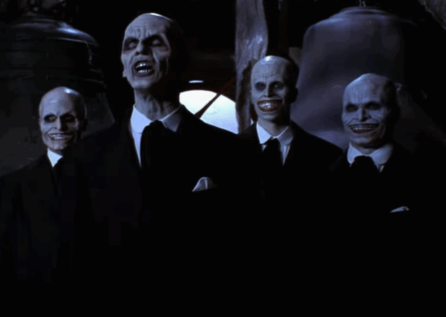
…The End!
Notes:
Image Source: https://www.businessinsider.com.au/buffy-episode-hush-was-a-masterpiece-2014-7
Context: The Gentlemen applaud each other after successfully obtaining another human heart

Slide 16
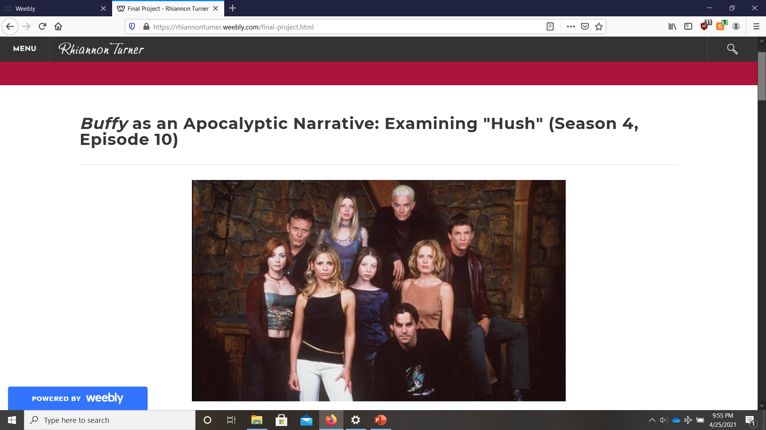
Final Project
You can find my full essay online at https://rhiannonturner.weebly.com/

Slide 17
References
Dornan, R. (2017, March 10). The unexpected parallels between Buffy the Vampire Slayer and Wellcome Collection. Wellcome Collection. https://wellcomecollection.org/articles/WsT4Ex8AAHruGfWh
Jenkins, A., & Stuart, S. (2003). Extending your mind: Non-standard perlocutionary acts in “Hush.” The Online International Journal of Buffy Studies. Retrieved April 26, 2021, from https://www.researchgate.net/publication/275963915_Extending_your_mind_non-standard_perlocutionary_acts_in_%27Hush%27
Kuhn, S. (2003, May 19). Joss Whedon interview. IGN. https://www.ign.com/articles/2003/05/19/joss-whedon-interview
Murray, N. (2009, August 14). Buffy the Vampire Slayer: "Hush" / "Doomed" / "A New Man" | Angel: s1/e10-12. The A.V. Club. https://tv.avclub.com/buffy-the-vampire-slayer-hush-doomed-a-new-ma-1798206906
Pallotta, F. (2014, July 28). Geek god Joss Whedon faced an epic challenge in this nearly silent 'Buffy’ episode. Business Insider. https://www.businessinsider.com/buffy-episode-hush-was-a-masterpiece-2014-7

Slide 18
References (cont.)
Russomanno, J. (2020, December 7). How Buffy’s “Hush” speaks to censorship. Slate. https://slate.com/technology/2020/12/buffy-vampire-slayer-hush-censorship-free-speech.html
Shade, P. (2005). Screaming to be heard: Reminders and insights on community and communication in “Hush.” The Online International Journal of Buffy Studies. Retrieved April 26, 2021, from http://www.whedonstudies.tv/uploads/2/6/2/8/26288593/shade_slayage_6.1.pdf
Whedon, J. (Director). (2003). Buffy the Vampire Slayer: The complete fourth season; DVD commentary for the episode “Hush.” [DVD]. 20th Century Fox.
Whedon, J. (Writer & Director). (1999, December 14). Hush (Season 4, Episode 10) [TV series episode]. In G. Berman, S. Gallin, F. R. Kuzui, K. Kuzui, & J. Whedon, Buffy the Vampire Slayer. Mutant Enemy Productions; 20th Century Fox Television.

